Slide 1
HAS COVID-19 IMPACTED THE AUSTRALIAN ECONOMY: AN ANALYSIS OF SINGLE TOUCH PAYROLL INDEX
Group members: Alison Beer, Kevin Truong, Dhananga Karunanayake

Slide 2
Motivation
To investigate whether COVID-19 has impacted single touch payroll in Victoria, Queensland and Western Australia.
Questions :
Has COVID-19 cases and resulting restrictions reduced single touch payroll index in Victoria?
How does Victoria compare to Western Australia and Queensland where the impact of COVID-19 and resulting restrictions were not as severe?
Has COVID-19 impacted the single touch payroll index for the accommodation and food services industry in Victoria?
Data :
Single touch payroll index data sourced from ABS website. ATO receives information from businesses with Single Touch Payroll (STP) via accounting software. Provides estimates of weekly payroll jobs and wages for assessing economic impact of COVID-19.
COVID-19 API data: https://covid19api.com/ and DHHS website.

Slide 3
Exploration and clean-up process
Single touch payroll data:
Renamed variables and columns
pd.to_numeric() - change strings to floats
Transpose dataframe
NaN values removed
.Loc to filter data
Drop rows not in date range
COVID-19 data:
used list comprehension on json response of API request to get active cases by state for Australia
Dates to datetime format
Used while loop to set time period, set conditions on df, calculated mean of average active cases for each week within the time period. Used timedelta(days=7) to move the start and end week dates to the next week ending period.

Slide 4
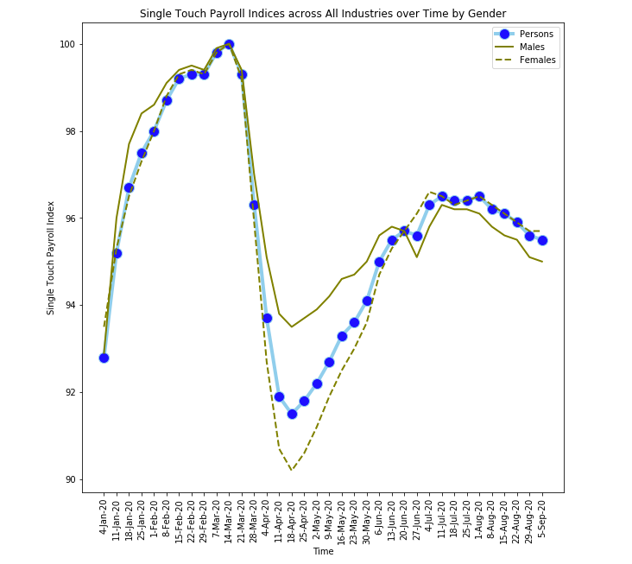
Analysis
Single touch payroll indexed to week ending 14 March 2020, by gender for Australia.
Time series analysis of % change in mean of COVID-19 active cases, and single touch payroll index, for weeks ending 14 March to 5 September.
Scatterplots and linear regressions

Slide 5
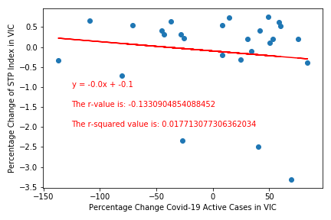
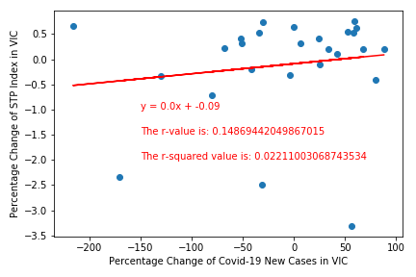
Victoria

Slide 6
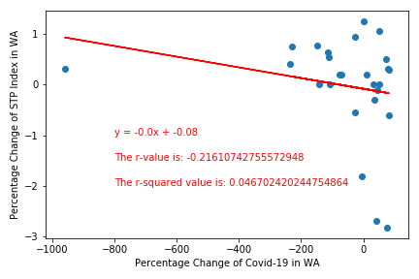
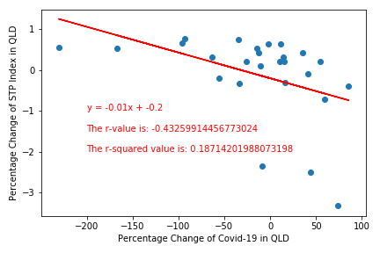
Western Australia
Queensland

Slide 7
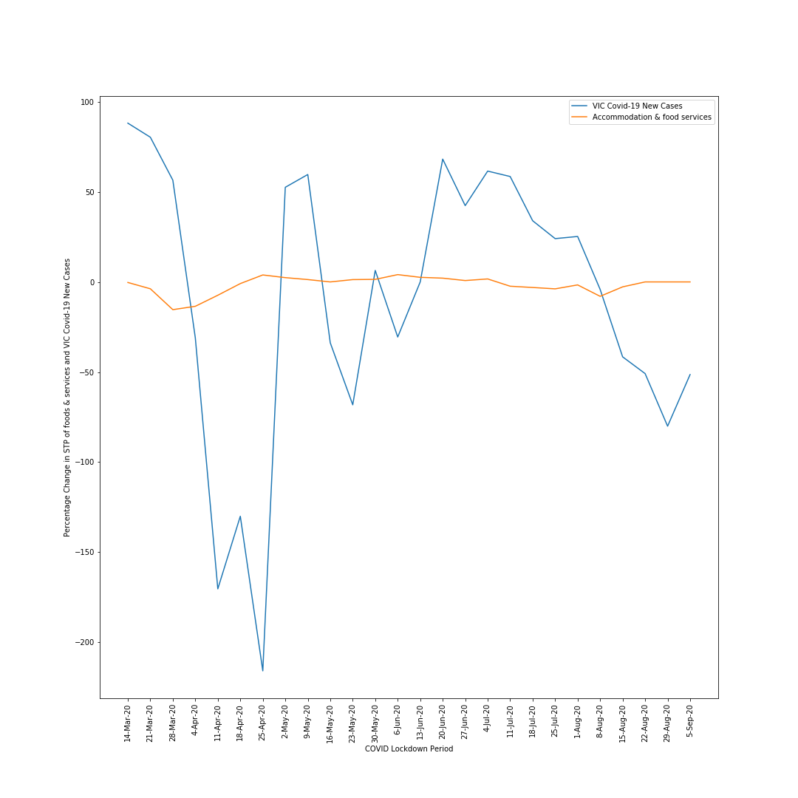
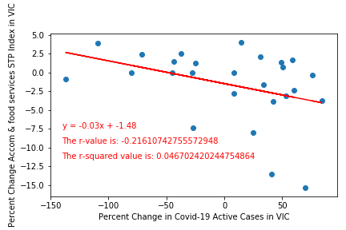
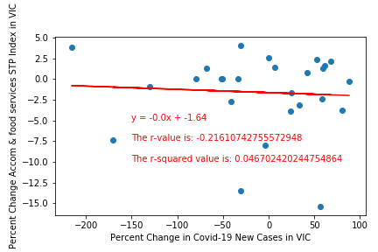
Victoria -
Accommodation & Food services industry
22 March : Prime minister announces stage 2 lockdown changes, which are progressively implemented
30 March : Prime minister announces Jobkeeper program
5 August : Stage 4 restrictions in metropolitan Melbourne and stage 3 restrictions in regional Victoria commence

Slide 8
Discussion
No relationship found between COVID-19 and single touch payroll for Vic, WA and Queensland
No relationship found between the STP accommodation and food industry index and COVID-19 cases. Time series showed some similar fluctuations between the variables.
Possible reasons for no relationship:
Data was heavily aggregated - payroll data was indexed to the week ending 14 March 2020. Could not access raw payroll data
STP system was introduced in July 2018 and is a relatively new method of reporting tax and superannuation information
Not all jobs and wages within the Australian labour market are captured within STP system
JobKeeper - Government policy to buffer economic impact of COVID-19
Technology allowed people to work from home
Restrictions allowed food service industry to continue to operate through takeaway

Slide 9
Post-mortem
Difficulties that arose :
Getting the COVID-19 data aggregated for the same weeks as the single touch payroll data
Questions that arose which we didn’t have time to answer :
Comparing other industries such as retail
Relationship with other labour force statistics such as employment
The number of payroll jobs is not the same as the number of employed people in labour force statistics:
Prior to the COVID-19 period, Australia showed that around 6% of employed people worked multiple jobs at the same time.
Each payroll job is counted separately in single touch payroll, however people have multiple job holdings
Analysis of secondary job holdings may provide further insight into how these data may relate to person based measures in labour force statistics.

